Slide 1
IBM University Engagement Project Submission
“Exploring the Power of Machine Learning with IBM Cloud”

Slide 2

InterviewAce-AI
Domain of Project – Education (AI-Powered Career & Interview Preparation)
Student Name | Recent Passport Photo | Email ID | Mobile number [WhatsApp]
JAHNAVI MARRAPU |  | mjahnavi121005@gmail.com | 9182496839

Slide 3
Problem Statement -
Problem Statement: Interview Trainer Agent
The Challenge
Preparing for job interviews can be difficult for students and job seekers due to the lack of personalized guidance, role-specific practice, and instant feedback. Traditional preparation methods rely on static question banks or costly mock interviews that do not adapt to an individual's skill level or career goals. Without an intelligent, real-time interview coach, many candidates struggle to identify weaknesses, improve communication skills, and build confidence before actual interviews.
The Objective
Build an AI-Powered Interview Trainer Agent that delivers personalized interview preparation using IBM watsonx.ai and Granite Large Language Models. The solution should:
Role-Based Interview Questions – Generate technical and HR interview questions based on the selected job role and experience level.
AI Answer Evaluation – Analyze user responses and provide detailed feedback, strengths, weaknesses, and improvement suggestions.
Interview Scoring System – Evaluate answers and assign scores based on accuracy, communication, and problem-solving ability.
Adaptive Question Generation – Dynamically adjust the difficulty of questions according to the candidate's performance.
Personalized Learning Recommendations – Recommend topics, resources, and practice areas to improve interview readiness.
Session History & Progress Tracking – Store previous interview sessions and monitor user improvement over time.
Multi-Role Support – Support interview preparation for Software Engineering, Data Science, AI/ML, Web Development, Cybersecurity, and other technical roles.
AI Interview Coach – Provide constructive feedback and model answers to help users understand the expected responses.
Performance Dashboard – Visualize interview scores, strengths, weak areas, and overall progress through interactive charts.

Slide 4
Proposed Solution -
Proposed Solution: AI-Powered Interview Trainer Agent
The proposed solution is an AI-powered Interview Trainer Agent built using Python, Streamlit, IBM watsonx.ai, and IBM Granite Models to provide personalized, interactive, and intelligent interview preparation. The system addresses the challenges faced by students and job seekers by generating role-specific interview questions, evaluating responses, and providing real-time feedback through an AI-powered conversational interface.
At its core, the solution uses IBM Granite Large Language Models (LLMs) to generate interview questions, assess candidate responses, and provide detailed explanations and improvement suggestions. The application maintains conversation history using Session State, enabling users to continue interview sessions seamlessly and track their learning progress.
The system consists of four key modules:
Interview Question Generator generates personalized technical and HR interview questions based on the selected job role and experience level.
Answer Evaluation Agent analyzes candidate responses for technical accuracy, clarity, communication, and completeness, while assigning a performance score and providing constructive feedback.
Learning Recommendation Agent identifies weak areas and recommends topics, learning resources, and practice strategies to improve interview performance.
Progress Tracking Dashboard stores interview history and visualizes scores, strengths, weaknesses, and improvement trends using interactive charts.
The solution includes a user-friendly Streamlit dashboard where users can choose their desired job role, answer AI-generated questions, receive instant evaluation, and monitor their interview preparation progress.
IBM watsonx.ai powers the reasoning and evaluation capabilities, while Granite models deliver high-quality question generation, response assessment, and personalized recommendations.
Overall, this solution delivers an end-to-end AI Interview Training Assistant that enhances technical knowledge, communication skills, and interview confidence, helping students and professionals prepare effectively for real-world recruitment processes.

Slide 5
Technology Used
IBM Granite Model (Granite-3.2 / Granite-4) – Used for generating personalized interview questions, evaluating candidate responses, providing intelligent feedback, scoring answers, and recommending improvements using natural language understanding and reasoning.
IBM watsonx.ai – Provides access to IBM Granite models through secure APIs, enabling AI-powered interview generation, response evaluation, and deployment on IBM Cloud.
IBM Cloud Lite – Offers the cloud infrastructure required to host, manage, and securely access IBM watsonx.ai services, ensuring a scalable and reliable AI application.
Python & Streamlit – Python is used for the application logic, while Streamlit provides an interactive and user-friendly web interface for conducting mock interviews and displaying AI-generated feedback.
Session State (Streamlit) – Maintains interview history, user responses, and conversation flow, enabling seamless multi-question interview sessions.
GitHub – Used for version control, source code management, collaboration, and project deployment.

Slide 6
Orchestrate Components Used –
1) User Input
Users select their Job Role, Experience Level, and enter interview answers through the Streamlit web interface.
2) IBM watsonx.ai Agent
Processes user inputs using IBM Granite models to generate interview questions, evaluate responses, assign scores, and provide personalized feedback.
3) IBM Granite Model
Granite-3.2-8B-Instruct (or the Granite model used in your IBM Cloud project) is responsible for question generation, answer evaluation, reasoning, and interview guidance.
4) AI Response Output
Displays AI-generated interview questions, performance scores, strengths, weaknesses, improvement suggestions, and model answers.
5) Session State
Maintains interview history, stores previous responses, tracks conversation flow, and enables continuous interview sessions.
6) Streamlit Dashboard
Provides an interactive web interface for selecting job roles, answering questions, viewing AI feedback, and monitoring interview progress.

Slide 7
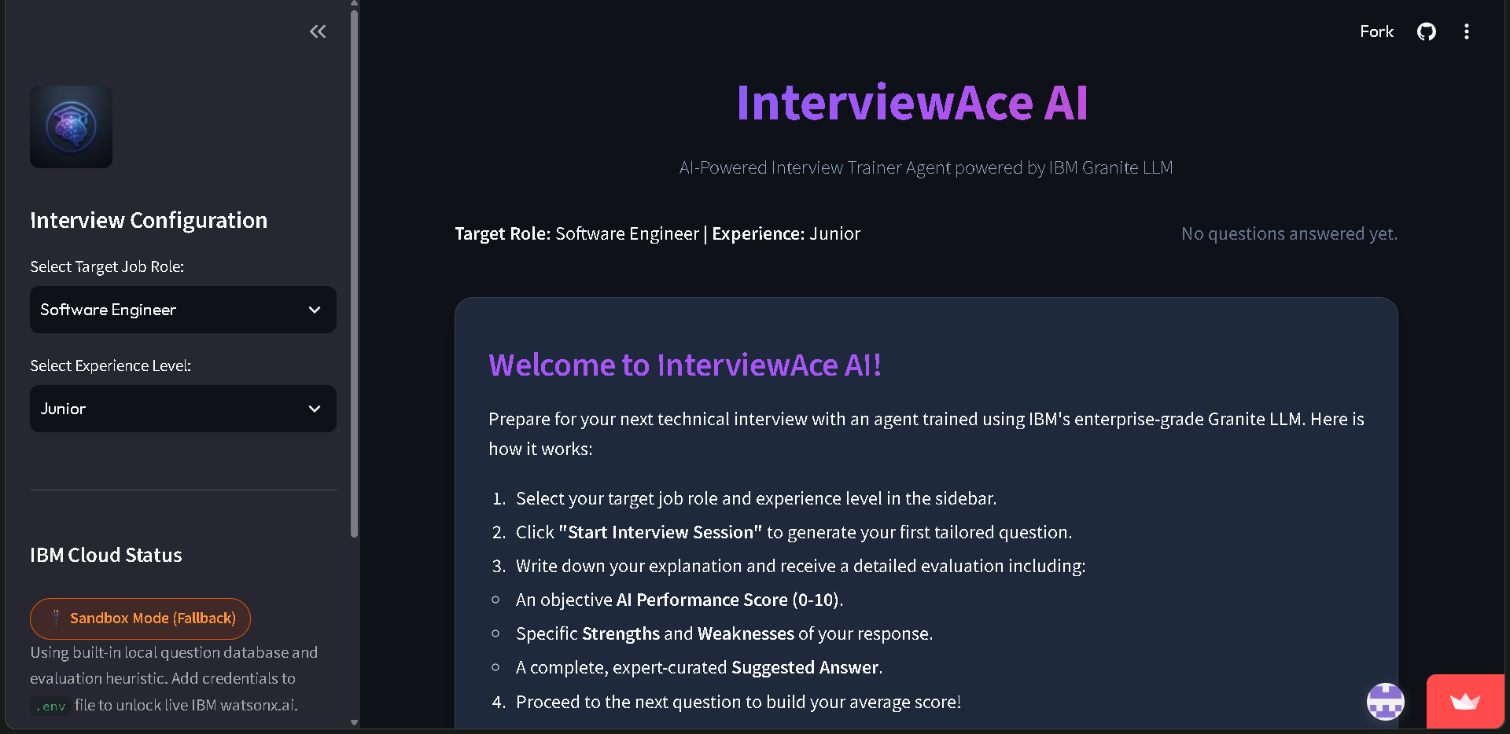
Screenshots-

Slide 8
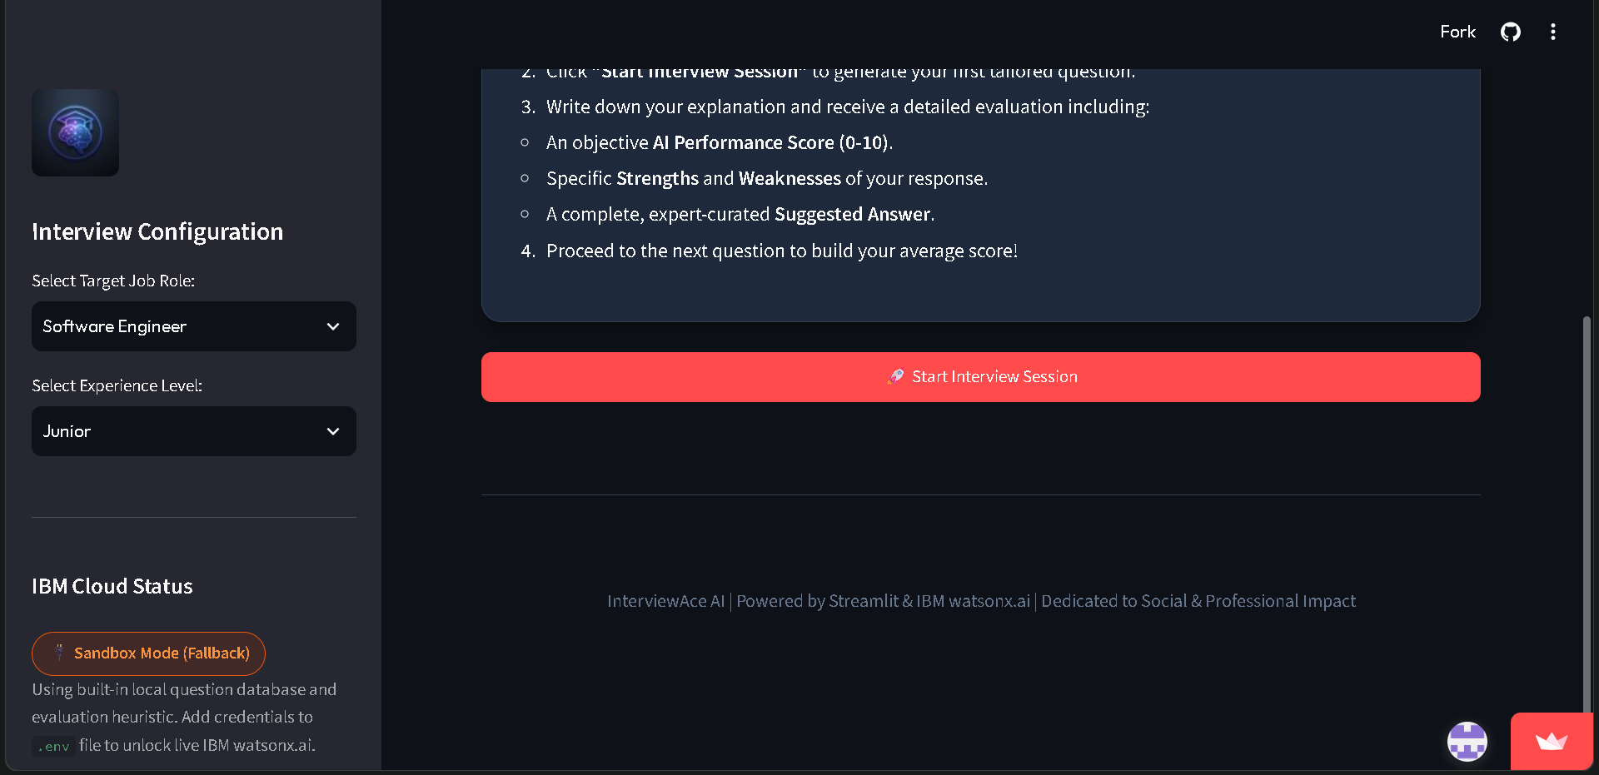
Choose targeted job role and experience level and then click on interview session for your interview preparation.

Slide 9
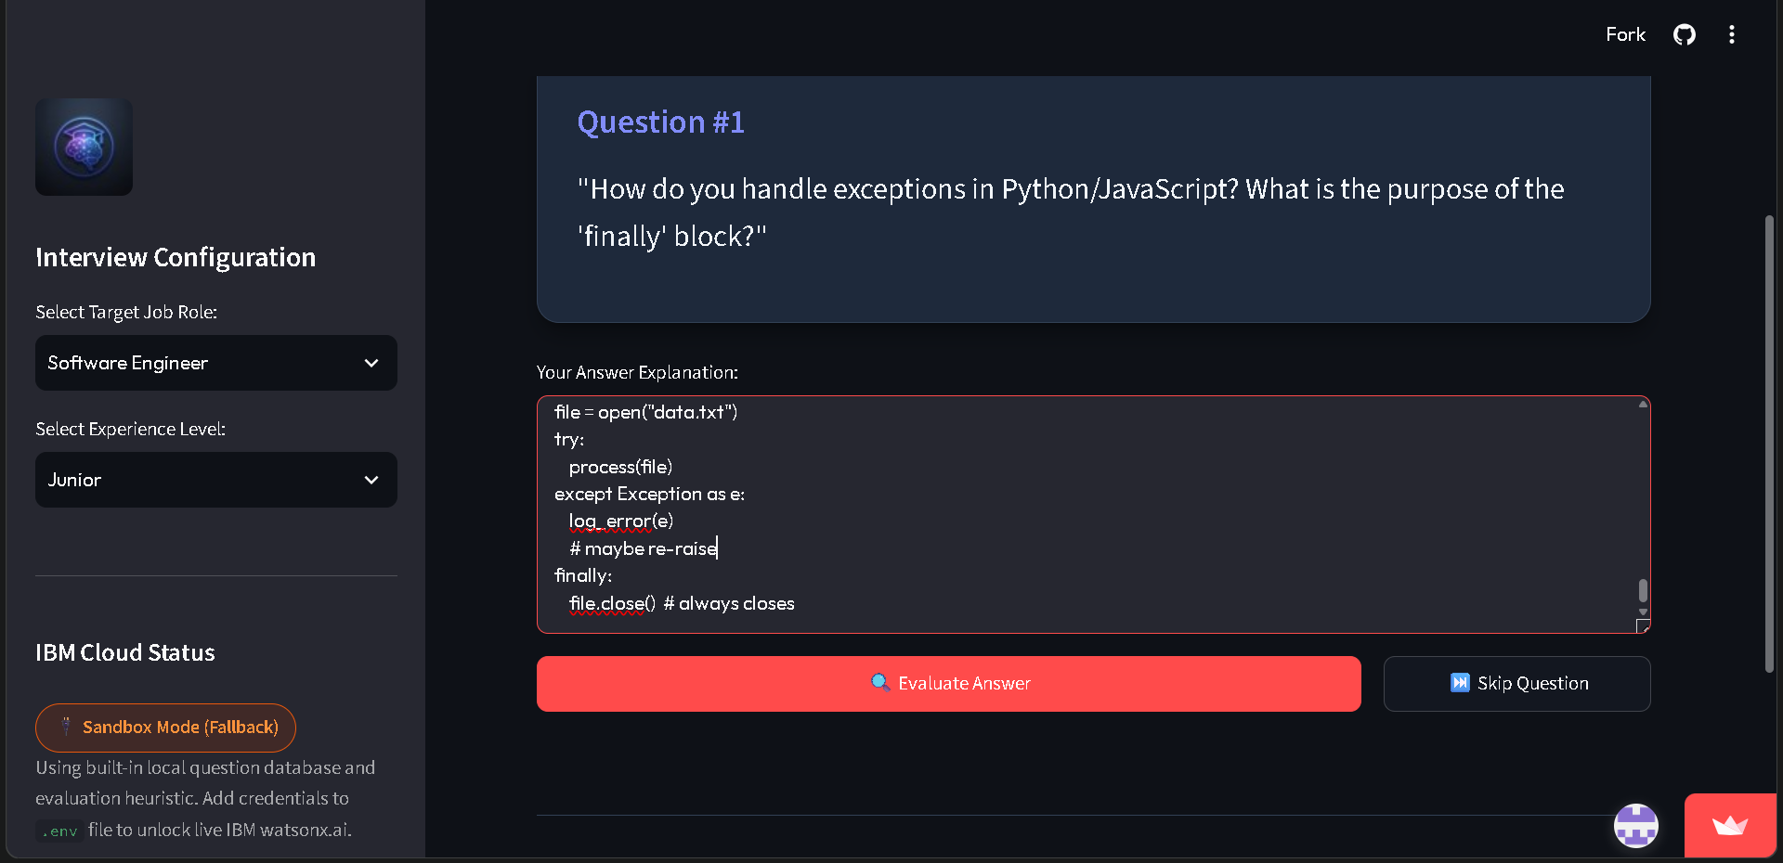
Type the answer in the text box and click on evaluate answer to view the result.

Slide 10
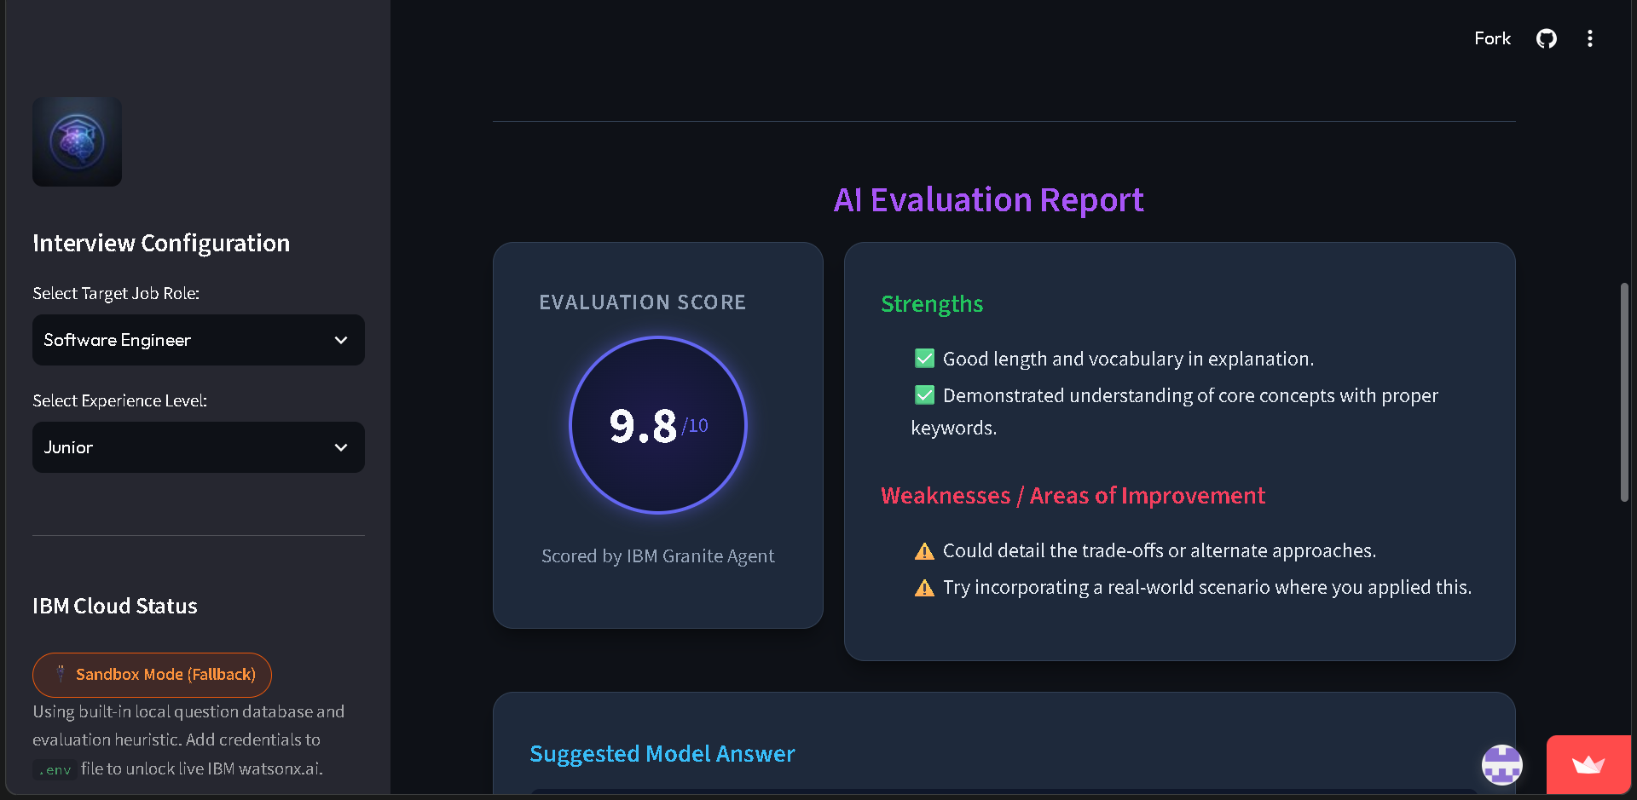
Evaluation report is generated to view your strengths and weaknesses.

Slide 11
Novelty and Uniqueness
The solution automates interview preparation by generating personalized interview questions and evaluating candidate responses in real time.
It uses IBM watsonx.ai and IBM Granite Models to provide intelligent interview simulations, answer evaluation, and personalized feedback without requiring manual assessment.
The system supports multiple job roles and experience levels through a single AI-powered interview training platform. AI-powered reasoning identifies strengths, weaknesses, and skill gaps, helping users improve their technical and communication abilities.
The solution ensures consistent, unbiased, and instant evaluation while providing actionable recommendations to enhance interview readiness and boost confidence.

Slide 12
Git Hub Link
https://github.com/Jahnavim12/InterviewAce-AI
App link
https://interviewace-ai-jahnavim12.streamlit.app/
·
·
·

Slide 13
Future Scope
The system can be integrated with college placement portals, Learning Management Systems (LMS), and recruitment platforms to provide personalized interview preparation for students and job seekers.
Additional company-specific interview modules (e.g., TCS, Infosys, Accenture, Amazon, Google, Microsoft) can be incorporated to simulate real recruitment processes.
Resume analysis, ATS score evaluation, and personalized career recommendations can be integrated to provide end-to-end placement assistance.
Advanced IBM watsonx.ai Granite models can continuously improve question generation, answer evaluation, and feedback quality using user interactions and updated industry requirements.
The solution can be enhanced with voice-based mock interviews, facial expression analysis, multilingual support, and real-time speech evaluation, making it a comprehensive AI-powered interview preparation platform for educational institutions, training centers, and recruitment organizations.
·
·
·

Slide 14
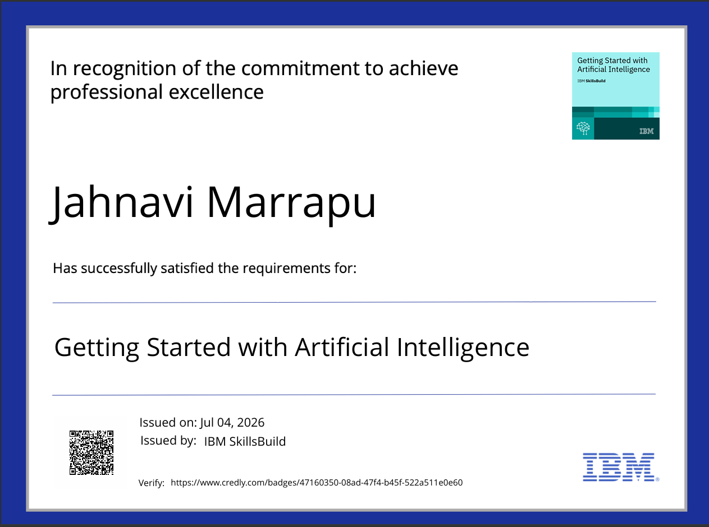
Certificates Earned:

Slide 15
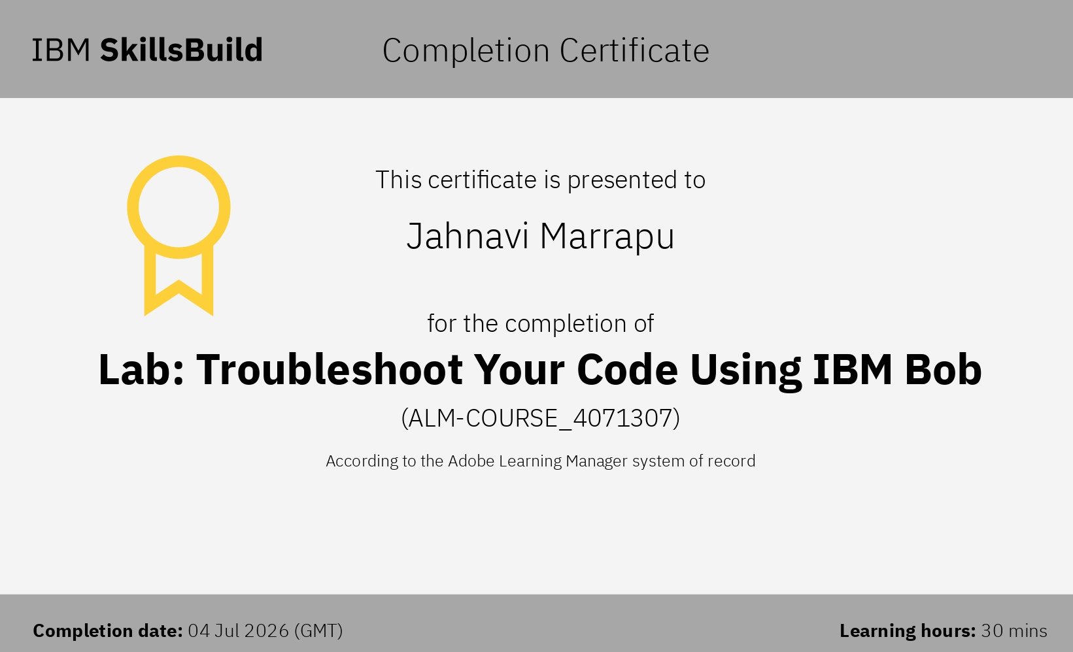
Certificates Earned:​

Slide 16


